Slide 1
PaintBot

Slide 2
Overview
Our project is a robot that paints in watercolor a draw from an app.
We are using an ESP32 to control two stepper motors. The motors move a robotic arm with a brush attached to it.
The user draws on our app and upload the draw to Firebase. The ESP downloads the data from firebase (WiFi) and moves the motors accordingly.

Slide 3
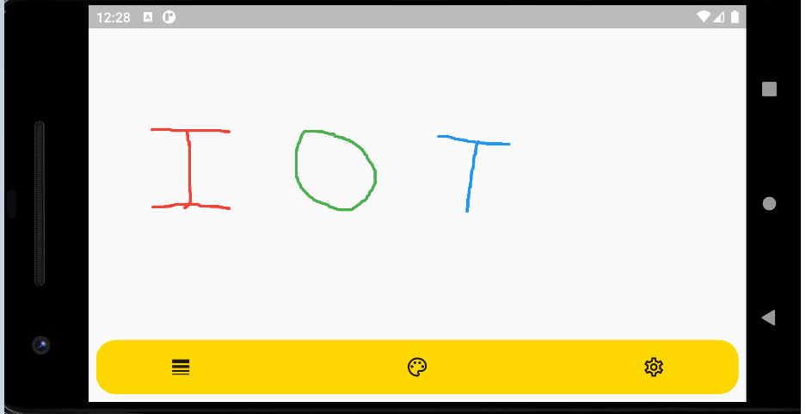
Flutter app

Slide 4
Achievements
We finished the drawing app.
We finished the main framework of the robot.
The Flutter-FireBase-ESP-Robot chain is complete.

Slide 5
Demo

Slide 6
Challenges
Add up-down feature for brush.
Fine tune robot moves to create a more accurate draw.
Add stop switches to allow “back home” feature.

Slide 7
Destination list
Hardware (Robot) | Hardware (ESP) | Application | Week
Add brush | Fine tune robot moves | Add up-down movement. Improve Bresenham algorithm. | 7
Add different paints and cleaning gear. | Add “back-home” feature and up-down movements (servo motor). | Add colors + stroke features. | 9
Move to welded and steady station. |  | Add user authentication | 11
Encapsulate robot in a final box | Final testing | Final testing | 13

